Slide 1
Creating Your Own Sermons Illustration Team
Finding Current & Relevant Illustrations That Are True!
By
Dr. Tom Cheyney
Greater Orlando Baptist Association
tcheyney@goba.org

Slide 2
Creating Your Own Sermons Illustration Team
Nothing is better for sermon preparation than when you have spent the time alone with God and have a clear direction for the upcoming message.
Perhaps only second, is when you find an awesome on-target illustration that supports what you are trying to communicate!

Slide 3
Creating Your Own Sermons Illustration Team
Today pastors and church planters spend huge sums of money for sermon illustrations. Type the term “sermons illustrations” into any search engine and you will find hundreds of companies that want to sell you their own illustrations.
BUT WHAT IF YOU COULD FIND YOUR OWN ON THE WEB IN JUST A FEW MINUTES?

Slide 4
Creating Your Own Sermons Illustration Team
Imagine finding fresh current stories, quotes, statistics, or humor that you can use -- fitting perfectly into what you are preaching this week.
Now you can learn how to search the 4,500+ news services daily.
You can find online magazines that have a particular special interest story you can use for emphasis.

Slide 5
Creating Your Own Sermons Illustration Team
It would be like hiring your own sermon illustrations team, would it not? CERTAINLY!
Imagine the wealth of ideas you could have to provide illustrative materials for each week’s message!
Wouldn’t it be great to hear your people talk about how current and relevant your messages have become?

Slide 6
Creating Your Own Sermons Illustration Team
Let me show you how to use online news services in your sermon preparation.
More than 4,500 news services add illustrative stories and useable quotes daily to their sites. Now you can search them for timely helps to add to your messages.
LET’S TAKE A WALK ON THE WEB!!!

Slide 7
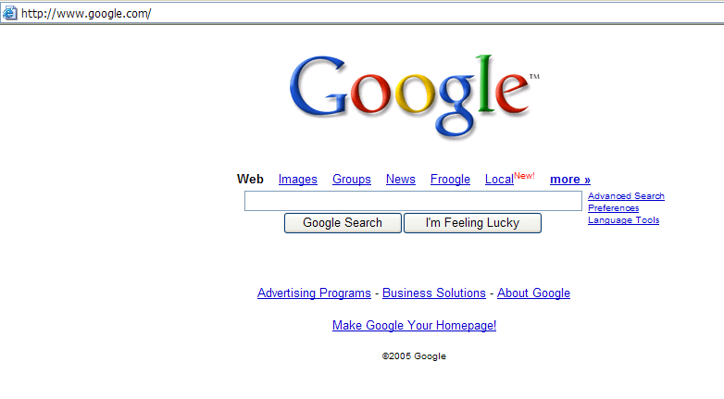
Creating Your Own Sermons Illustration Team
Go to:
www.google.com

Slide 8
Creating Your Own Sermons Illustration Team
Click On:
News

Slide 9
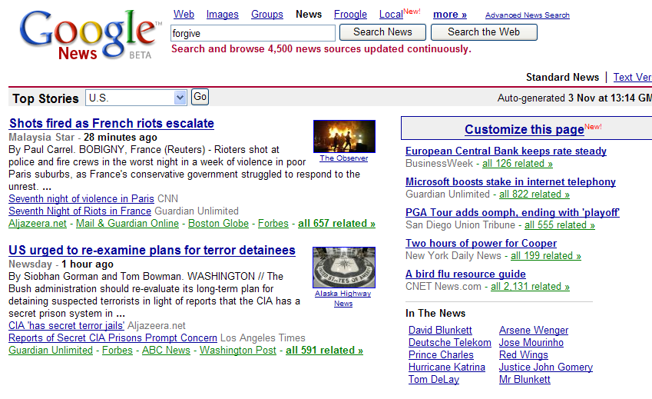
Type in a key word example: "forgive"
Click on Search News
Look @ next page to
see what you get!

Slide 10
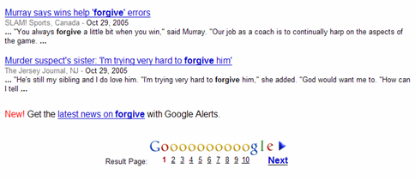
Page will look like this!
Click on what you want to see.
Go to next page!

Slide 11
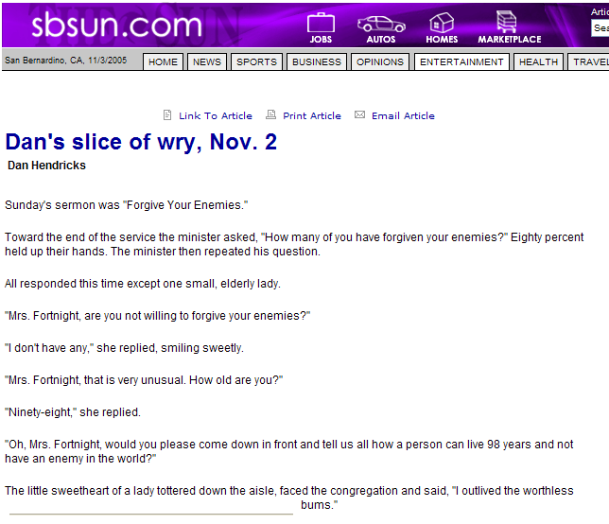
Creating Your Own Sermons Illustration Team
Now read and laugh!

Slide 12
Try looking at this British site:
www.ananova.com

Slide 13
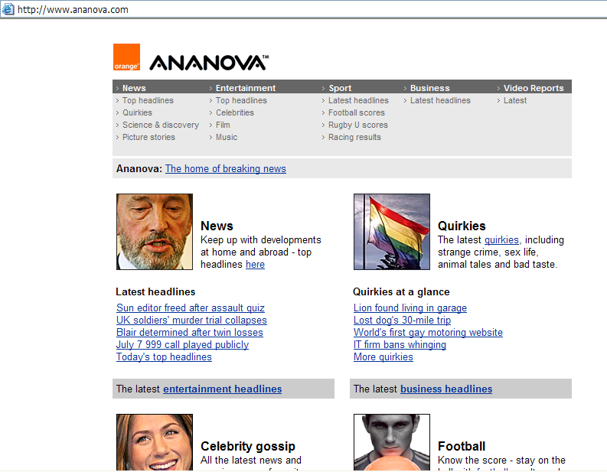
Don't miss the "Quirkies" section!
Click on:
"quirkies"

Slide 14
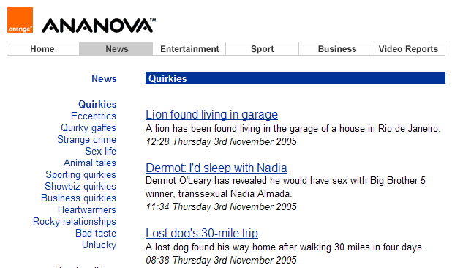
Creating Your Own Sermons Illustration Team
Notice & Click on:
Rocky relationships
Go to next slide!

Slide 15
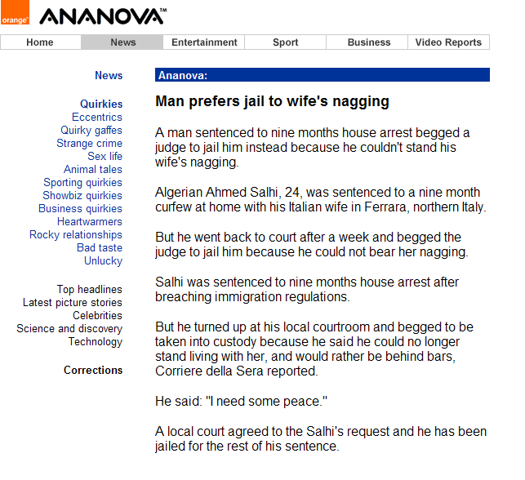
Creating Your Own Sermons Illustration Team
Here you go!

Slide 16
Creating Your Own Sermons Illustration Team
If you want to get the top ten daily stories sent to you on a specific topic, you can do so by clicking on the following icon and supplying information.

Slide 17
Click here!

Slide 18
Creating Your Own Sermons Illustration Team
With the world-wide-web at your fingertips, you can now find new and refreshing illustrations. You will instantly discover how easy it really is to be current and relevant in your stories, quotes, statistics, or humor.

Slide 19
Creating Your Own Sermons Illustration Team
Give it a try and you will find just how easy it is! Better yet, discover how much better your messages become as you creatively communicate God’s word with freshness and vitality like never before.

Slide 20
Creating Your Own Sermons Illustration Team
Finding Current & Relevant Illustrations That Are True!
By
Dr. Tom Cheyney
Greater Orlando Baptist Association
tcheyney@goba.org

